Slide 1
On Language Support for Fault-Tolerance in Distributed Systems
Damien Zufferey, MIT CSAIL
EC2, 2016.7.18
Notes:
Joint work with
Cezara Dragoi
Tom Henzinger
Josef Widder
Helmut Veith

Slide 2
Distributed Systems
“A distributed system is one in which the failure of a computer you didn’t even know existed can render your own computer unusable.”
Leslie Lamport
How to get it right when it goes wrong ?
(And how PL abstractions can help ?)

Slide 3
What do Failures Impact ?
Computation
Data
It is possible to recompute
(if we have the data).
Strategies:
Supervision
Checkpoint
…
Lost data are lost …
Strategies:
Replication
…

Slide 4
Supervision
Single point of failure
Master
Worker
Worker
Worker

Slide 5



Replication

Slide 6
Replication and Consistency
X = -13
Consensus
X = 42
X = 4
X = 42
X = 42
X = 42

Slide 7
What is (A)synchrony?
(Non-)blocking operations
(Un)timed model
RPC vs message-passing
Method call vs future
…
Send/recv vs latency/bandwidth
…
Not necessarily real time
Logical time
Scheduling fairness

Slide 8
The Paxos Algorithm [Lamport 98]
Prepare
Promise
Accept
Accepted
Learning
Proposer
Acceptor/Learner
Acceptor/Learner
Used at Google (Chubby, Spanner), Microsoft (Autopilot), …
Notes:
Principle
establish majority
witness majority
decision becomes effective
Retry if fails
Not Alice and bob, or in the slides

Slide 9
Network Communication is Untyped
Type object;
serialization
Type object;
send(channel, object);
Byte[] objAsBytes;
Byte[] objAsBytes;
send(channel, objAsBytes);
011001010101…
recv(channel, objAsBytes);
Type object =
recv(channel);
deserialization
Type object;
Notes:
It is up to the programmer to give an interpretation to bytes.
The type of messages changes over time (protocol).
Messages breaks the control-flow.
*What happens when you get to the boundary of the PL*

Slide 10
Communication Faults and Control-Flow (1)
Cannot block on reception:
START
CANCEL
Timer
CANCEL_SUCCESS
TIMEOUT
CANCEL_FAILURE
set timer;
wait for message;
message
timeout
cancel timer;
process timeout;
success
fail
message
process message;
wait for timeout;
process message;
???

Slide 11
Communication Faults and Control-Flow (2)
Protocol structure replaced by dispatch:
var state = 1
while (true) {
on receive {
case Msg A =>
if (state == 1) …
else if (state == 2) …
case Msg B =>
if (state == 1) …
else if (state == 2) …
}
}
Protocol:
Msg A
Msg B
normal case
message reordered
message dropped
normal case

Slide 12
Asynchronous Programming Model and Faults
Asynchrony
Actor model, CSP,
CCS, pi-calculus, …
Many PL based on or implementing these models
Fault
Consensus is not solvable with asynchrony and faults [FLP 85].
Waiting for a message
Notes:
Fault: alternation between synch and async.
Result: complex code, timer all over the place

Slide 13
Paxos in the Literature
The part-time parliament [Lamport 98]
Paxos made simple [Lamport 01]
Paxos made live: An engineering perspective [Chandra et al. 07]
In search of an understandable consensus algorithm [Ongaro and Ousterhout 14]
Paxos made moderately complex [van Renesse and Altinbuken 15]
Paxos made transparent [Cui et al. 15]
...
Question:
Could the same problem be simpler in different model ?
(What it a good programming model for such algo. ?)
Notes:
Paxos is also know to confuse people

Slide 14
PSync
PSync is a DSL to simplify the implementation and reasoning about fault-tolerant algorithms.
Simple round-based model
Efﬁcient runtime system
Automated veriﬁcation
source code + specifications
runtime
verifier
executable
proof or
counterexample
Notes:
Decouple network and timer code from the logic
We are not going to replace Paxos but get you part of the way

Slide 15
Why is Verification Hard ?
n
Parametric systems
Asynchrony (interleaving, delays)
Channels
Faults
…
Instead we use a model where such challenge do not even exists:
Communication-closed rounds
Environment as an adversary
Notes:
Picking the right model to make verification easier
Parametric systems: undecidable in general
Interleaving: combinatorial blow-up
Channels: undecidable if FIFO, non-primitive recursive if lossy

Slide 16
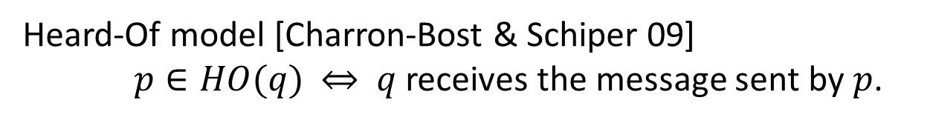
Faults as an adversarial Environment [Gafni 98]
Abstraction:
Execution:
Heard-Of model [Charron-Bost & Schiper 09]
$p∈HO(q)$ $⇔$ $q$ receives the message sent by $p$.
Notes:
We formalize the correspondence between the two worlds in terms of observational refinement.

Slide 17
Communication-closed Rounds [Elrad & Francez 82]
Prepare
Promise
Accept
Accepted
Learning
Proposer
Acceptor
Acceptor
A round is
a logical unit of time,
a scope for the messages.

Slide 18
PSync Program Structure
Program
Round_{T}

Slide 19
PSync Lockstep Semantics
Init
Round[0]
Round[1] …
Round[ i mod r ]
Send
Update
Env (HO)
Challenge:
Executing the lockstep semantics on a system which
is not synchronous and provide liveness guarantees.
Notes:
Says what r is

Slide 20
Example: Paxos (Last Voting)
Promise
Accept
Accepted
Learning
Coordinator
new Round[(Int,Time)]{
def send(): Map[ProcessID, (Int,Time)] = Map( coord -> (x, ts) )
def update(mailbox: Map[ProcessID, (Int,Time)]) {
if (id == coord && mailbox.size > n/2) {
vote = valueWithMaxTS(mailbox)
commit = true
}
} }
Notes:
.maxBy(_._2._2)._2._1 // value with maximal ts

Slide 21
Paxos in Full
new Round[(Int,Time)]{
def send(): Map[ProcessID, (Int,Time)] =
Map(coord -> (x, ts))
def update(mailbox: Map[ProcessID, (Int,Time)]) {
if (id == coord && mailbox.size > n/2) {
vote = valueWithMaxTS(mailbox)
commit = true
}
} }
new Round[Int]{
def send(): Map[ProcessID,Int] =
if (id == coord && commit) broadcast(vote)
else Map.empty
def update(mailbox: Map[ProcessID,Int]) {
if (mailbox contains coord) {
x = mailbox.get(coord)
ts = r/4
} } }
new Round[Int]{
def send(): Map[ProcessID,Int] =
if ( ts == r/4 ) Map( coord -> x )
else Map.empty
def update(mailbox: Map[ProcessID,Int]) {
if (id == coord && mailbox.size > n/2)
ready = true
} }
new Round[Int]{
def send(): Map[ProcessID, Int] =
if (id == coord && ready) broadcast(vote)
else Map.empty
def update(mailbox: Map[ProcessID,Int]) {
if (mailbox contains coord))
decide( mailbox(coord) )
ready = false; commit = false
} }

Slide 22
Preserving Local Views
Theorem
Lockstep:
Indistinguishable
Runtime:
Indistinguishability
for every process p, the transitions and states of the projection
of the traces on p agree up to finite stuttering.
Notes:
Importance:
if a process cannot distinguish between two executions then it produce the same result
No Assumptions for safety
Partial Synchrony for liveness

Slide 23
Runtime Algorithm
Send
Accumulate
Receive
Next round
Catching up
Discard late
messages
TO
Update
Preserve liveness assuming partial synchrony [Dwork et al. 88]
Notes:
TODO as an automaton

Slide 24
Partial Synchrony: Lockstep Trace from an Exec.
For every runtime execution, we build an indistinguishable lockstep execution.
Runtime Execution
Synchronized
Asynchronous
Asynchronous
Respects liveness assumptions
Network
Asynchronous
Synchronous
GST
Notes:
Crashed processes cannot distinguish!!

Slide 25
From Indistinguishability to Refinement
Client₁
Init
Init
Client₂
Decide
Decide
Client₃
Init
Decide
Theorem: Observational refinement
Clients ∥ Runtime(P) ⊆ Clients ∥ Lockstep(P)
Notes:
Client communicate only with one process
Operation commutes across processes

Slide 26
Benefits for Verification
Reason about rounds in isolation.
Lockstep semantics, no interleaving.
Promise
Accept
Simple invariants that connects the round at the boundaries.
No message in flight, only local state of the processes.
Previous work on a logic verification of consensus algorithms [VMCAI 14]
Notes:
Reasoning in round-based model (partial synchrony):
Communication-closed rounds (simple model for the channels)
Lockstep semantics (no interleaving, mapping asynchrony to faults)
Heard-of model: map process faults on communication faults

Slide 27

Implementation
https://github.com/dzufferey/psync
Implemented in Scala, Apache 2.0 license

Slide 28
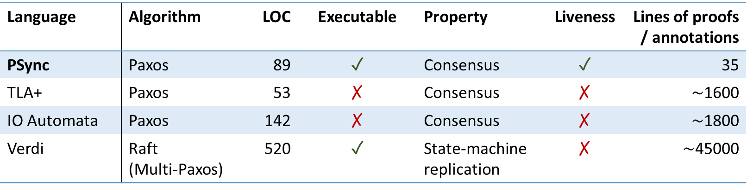
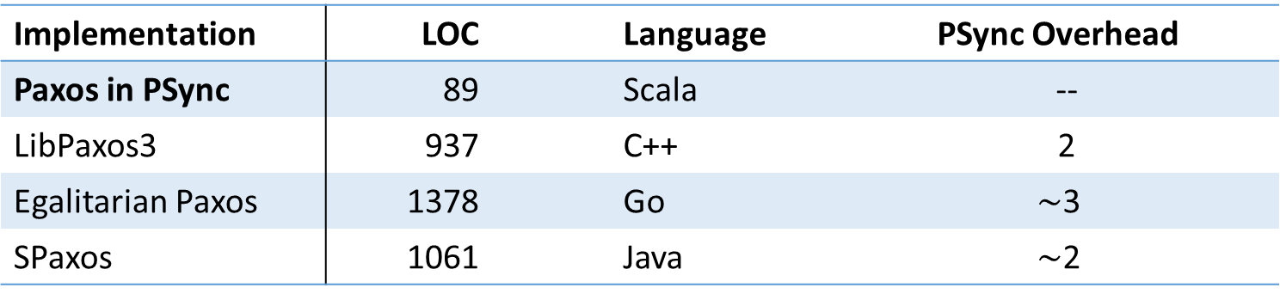
Paxos in PSync
Language | Algorithm | LOC | Executable | Property | Liveness | Lines of proofs / annotations
PSync | Paxos | 89 | ✓ | Consensus | ✓ | 35
TLA+ | Paxos | 53 | ✗ | Consensus | ✗ | $∼$1600
IO Automata | Paxos | 142 | ✗ | Consensus | ✗ | $∼$1800
Verdi | Raft (Multi-Paxos) | 520 | ✓ | State-machine replication | ✗ | $∼$45000
Implementation | LOC |  | Language | PSync Overhead
Paxos in PSync | 89 |  | Scala | --
LibPaxos3 | 937 |  | C++ | 2
Egalitarian Paxos | 1378 |  | Go | $∼$3
SPaxos | 1061 |  | Java | $∼$2
Notes:
Paxos in less than 100 LOC and proof in less than 100 LOC
Use Verdi to make the point about DSLs
PSync is a DSLs so it embeds into a general purpose language

Slide 29
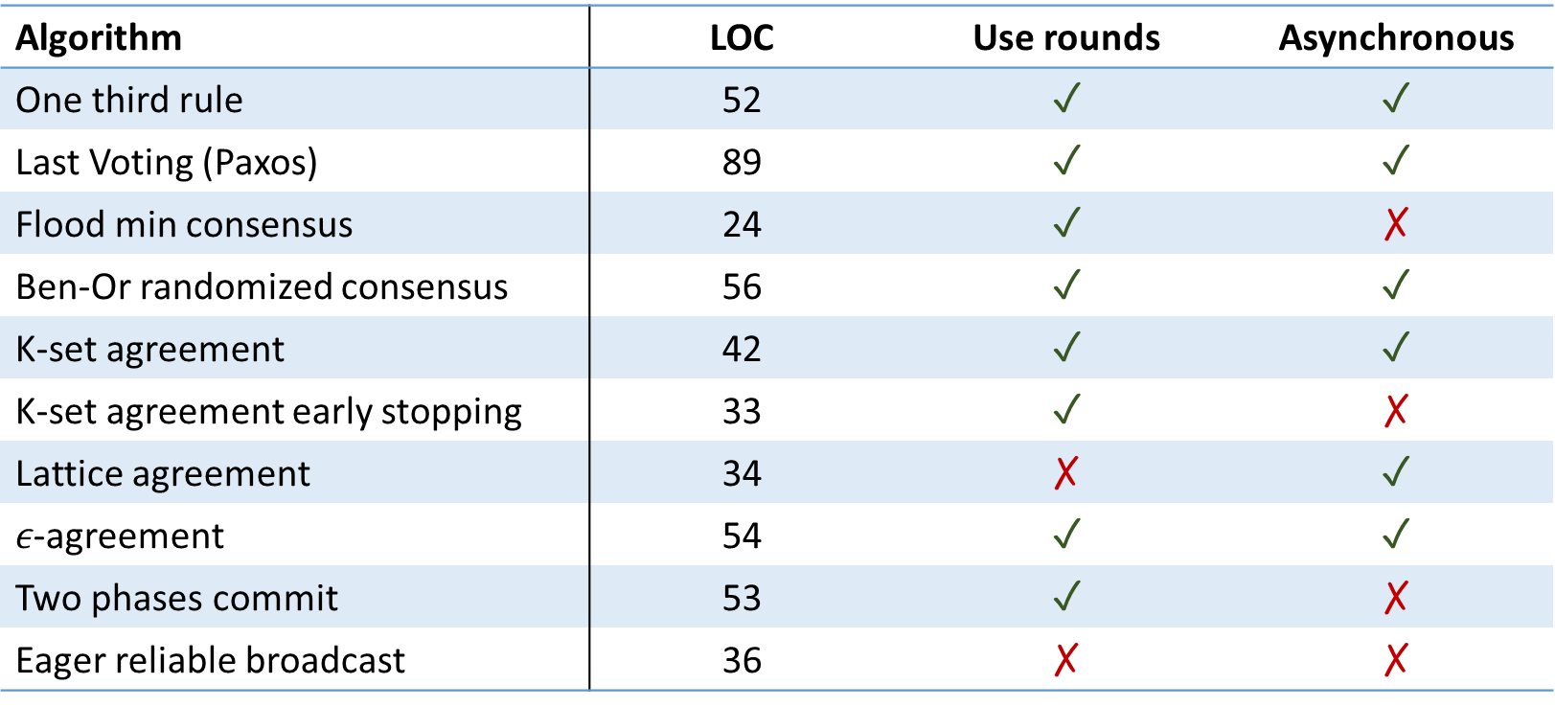
Do Algorithms use Rounds ?
Algorithm | LOC | Use rounds | Asynchronous
One third rule | 52 | ✓ | ✓
Last Voting (Paxos) | 89 | ✓ | ✓
Flood min consensus | 24 | ✓ | ✗
Ben-Or randomized consensus | 56 | ✓ | ✓
K-set agreement | 42 | ✓ | ✓
K-set agreement early stopping | 33 | ✓ | ✗
Lattice agreement | 34 | ✗ | ✓
$ε$-agreement | 54 | ✓ | ✓
Two phases commit | 53 | ✓ | ✗
Eager reliable broadcast | 36 | ✗ | ✗

Slide 30
Code Size (Easy to Implement)
Paxos in | LOC | Executable | Verification
PSync | 89 | ✓ | Semi-automated
DistAlgo | 43 | ✓ | ✗
Distal | 157 | ✓ | ✗
Overlog | 107 | ✓ | ✗
TLA+ | 53 | ✗ | Interactive
IO Automata | 142 | ✗ | Interactive
EventML | 1729 N | ✓ | Interactive
Verdi (Raft) | 520 | ✓ | Interactive
Bloom | 224 | ✓ | ✗

Slide 31
Paxos in PSync
Language | Algorithm | LOC | Executable | Property | Liveness | Lines of proofs / annotations
PSync | Paxos | 89 | ✓ | Consensus | ✓ | 35
TLA+ | Paxos | 53 | ✗ | Consensus | ✗ | $∼$1600
IO Automata | Paxos | 142 | ✗ | Consensus | ✗ | $∼$1800
Verdi | Raft (Multi-Paxos) | 520 | ✓ | State-machine replication | ✗ | $∼$45000
Implementation | LOC |  | Language | PSync Overhead
Paxos in PSync | 89 |  | Scala | --
LibPaxos3 | 937 |  | C++ | 2
Egalitarian Paxos | 1378 |  | Go | $∼$3
SPaxos | 1061 |  | Java | $∼$2
Notes:
Paxos in less than 100 LOC and proof in less than 100 LOC
Use Verdi to make the point about DSLs
PSync is a DSLs so it embeds into a general purpose language

Slide 32
Conclusion
PSync uses a simple programming abstraction: the HO-model
Lockstep semantics
Communication-closed rounds
Asynchrony and faults as an adversary that drops messages
Automated verification becomes possible
Runtime
Asynchronous semantics indistinguishable from the lockstep semantics
Can be implemented efficiently

Slide 34
Example: Last Voting Algorithm (2)
Collect
Candidate
Quorum
Accept
Coordinator
new Round[Int]{
def send(): Map[ProcessID,Int] =
if (id == coord && commit) broadcast(vote)
else Map.empty
def update(mailbox: Map[ProcessID,Int]) {
if (mailbox contains coord) {
x = mailbox.get(coord)
ts = r/4
} } }
Notes:
remove

Slide 35
Example: Last Voting Algorithm (3)
Collect
Candidate
Quorum
Accept
Coordinator
new Round[Int]{
def send(): Map[ProcessID,Int] =
if ( ts == r/4 ) Map( coord -> x )
else Map.empty
def update(mailbox: Map[ProcessID,Int]) {
if (id == coord && mailbox.size > n/2)
ready = true
} }

Slide 36
Example: Last Voting Algorithm (4)
Collect
Candidate
Quorum
Accept
Coordinator
new Round[Int]{
def send(): Map[ProcessID, Int] =
if (id == coord && ready) broadcast(vote)
else Map.empty
def update(mailbox: Map[ProcessID,Int]) {
if (mailbox contains coord))
decide( mailbox(coord) )
ready = false; commit = false
} }

Slide 37
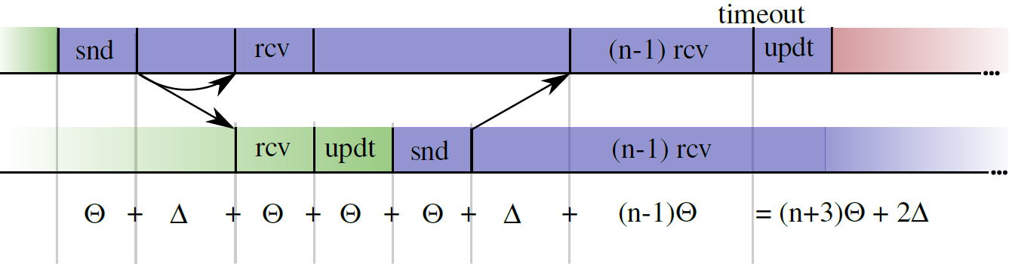

Synchronizing: Choosing the Timeout
$Θ$: time needed for the slowest process to make a step
$Δ$: network delay
After GST, $Θ$ and $Δ$ holds

Slide 38
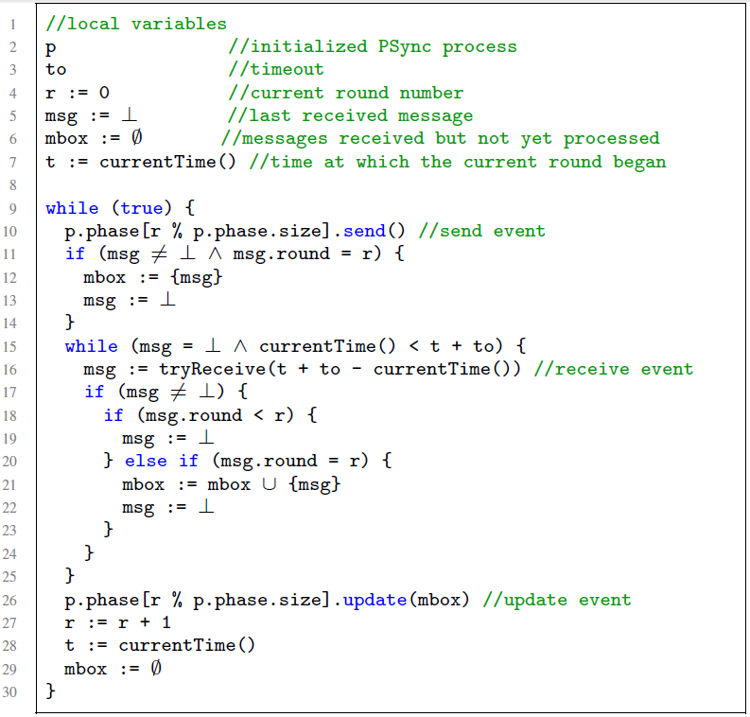
Runtime Algorithm
Round operations
Accumulate messages
Discard late messages
Catching up
Notes:
TODO as an automaton

Slide 39
Correctness of Fault-tolerant Algorithms
Majority of acceptors
Majority of acceptors
Non-empty intersection
enforces unique decision

Slide 40
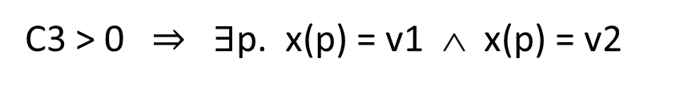
Reasoning about Set Comp. and Cardinalities
A
B
|A| > n/2 ∧ |B| > n/2 ∧ v1 ≠ v2 ∧
C3
A = { p. x(p) = v1 } ∧ B = { p. x(p) = v2 }
C1
C2
C4
Venn regions
Linking cardinality and data
C1 + C3 > n/2
C2 + C3 > n/2
C1 + C2 + C3 + C4 = n
C1, C2, C3, C4 ≥ 0
n ≥ 1
C3 > 0 $⇒$ $∃$p. x(p) = v1 ∧ x(p) = v2
Complete decision procedure requires constructing the full model. (Small model property)
Notes:
Z3 does not natively handle comprehension and card. We have to do something more.
In this example we ask the solver for a counterexample: 2 different decisions

Slide 41
















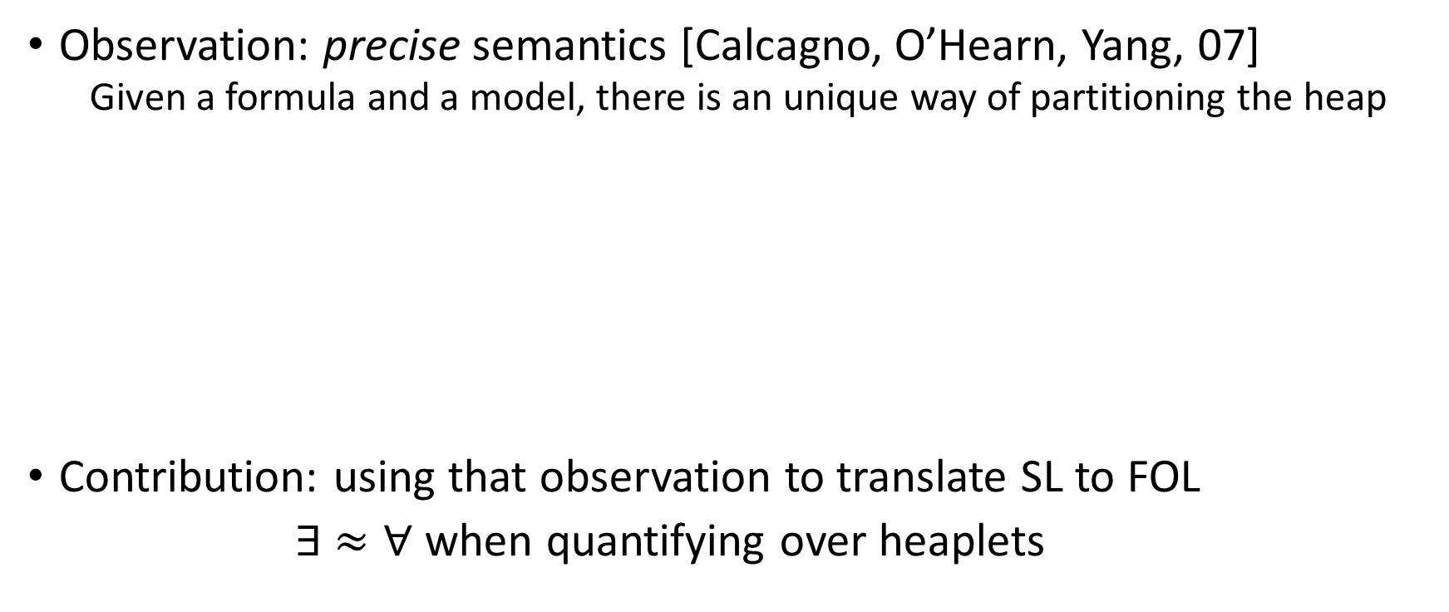
Invariant for Agreement
$$∀i. ¬decided\left(i\right)∧¬ready\left(i\right)$$
$$∀i. ¬decided\left(i\right)∧¬ready\left(i\right)$$
$$∨$$
$$∨$$
$$∃ v, t, A. A=\left\{ i. ts\left(i\right)>t\right\}∧\left|A\right|>n/2$$
$$∧$$
$$∀i. i∈A⇒x\left(i\right)=v$$
$$∧$$
$$∧$$
$$∀i. decided(i)⇒x\left(i\right)=v$$
$$∀i. decided(i)⇒x\left(i\right)=v$$
$$∧$$
$$∧$$
$$∀i. commit\left(i\right)∨ready(i)⇒vote\left(i\right)=v$$
$$∀i. commit\left(i\right)∨ready(i)⇒vote\left(i\right)=v$$
$$t≤Φ$$
$$∧$$
$$t≤Φ$$
$$∧$$
$$∧$$
$$∧$$
$$∀i. ts\left(i\right)=Φ⇒commit(coord)$$
$$∀i. ts\left(i\right)=Φ⇒commit(coord)$$

Slide 42
Preserving Global Properties
Theorem:
Given a specification S closed under indistinguishability,
if a PSync program P satisfies S then
the asynchronous semantics of P refines S.
Consensus is closed under indistinguishability.
Verification engine for safety and liveness properties based on SMT.

